Slide 1

Soybean Weed Control for New Agents
Eric P. Prostko
Professor and Extension Weed Specialist
Dept. Crop & Soil Sciences

Slide 2
Georgia Soybean Acres
Planted (X 1000)
Year
Source: NASS

Slide 3
Soybean Production In Georgia Yield (Bu/A)
Source: NASS

Slide 4
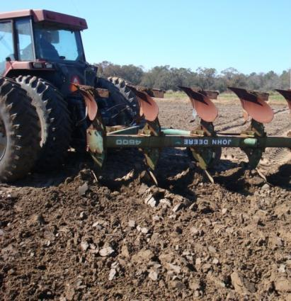
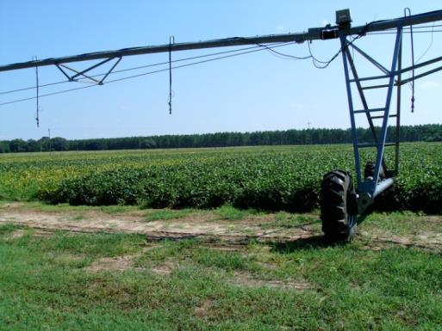
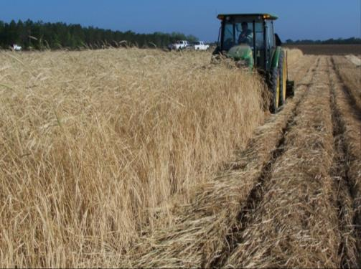
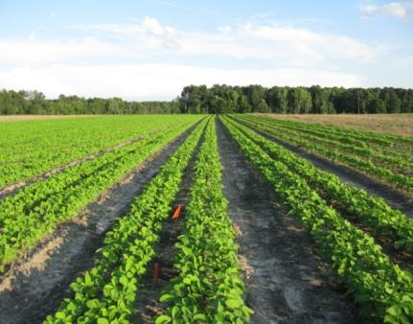
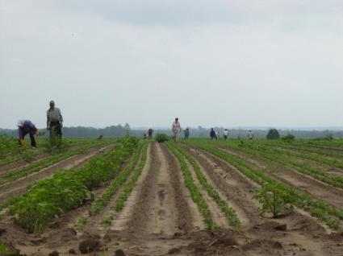
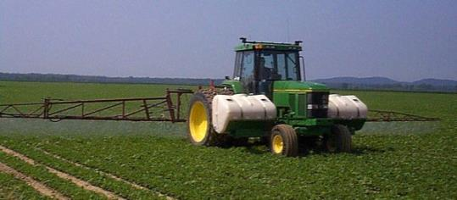
Soybean Weed Control
Integrated Program Approach
Rye Cover
Irrigation
Tillage
Narrow Rows
Hand-Weeding
Herbicides

Slide 5
Question?
What is 1 practice that all GA soybean growers could do and immediately help improve weed control and increase yields?

Slide 6
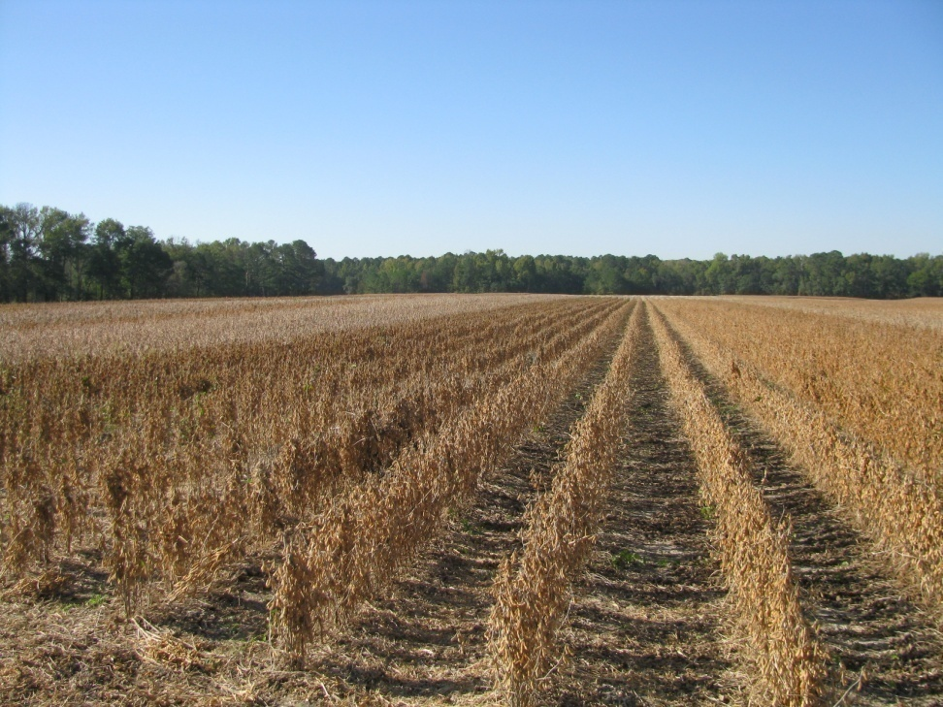
Row Spacing Effects on Soybean Yield In Georgia
Carter and Boerma, 1979 (Athens, GA)
  38” to 19” = 11% yield increase
Parker et al., 1981 (Tifton, GA)
  36” to 18” = 4% increase
Boerma and Ashley, 1982 (Plains, GA)
  36” to 20” = 17% yield increase
Ethredge et al., 1989 (Plains, GA)
  30” to 20” = 8% yield increase
  30” to 10” = 11% yield increase
  20” to 10” = 3% yield increase
Woodruff, 2007-2008 (Camilla, GA)
  36” to 24” = 8% yield increase
Washington County, GA (2008)
“A review of row spacing experiments in which an initial weed management practice had been accomplished revealed that in 64% of the cases (72 of 113 site-years), less late-season weed density and/or biomass, or greater late-season weed control, was achieved in narrow- compared to wide-row soybean production systems.”
Bradley, K. W. 2006. A review of the effects of row spacing on weed management in corn
and soybean. Online. Crop Management doi:10.1094/CM-2006-0227-02-RV.

Slide 7
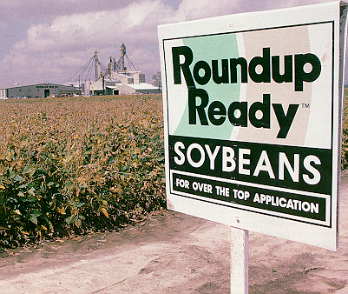
What did we do before RR soybeans?
Prowl, Treflan, Canopy, Sencor/Lexone, Lorox, Pursuit, Scepter, Gemini, Cobra, Blazer
Sicklepod was a major problem
2,4-DB @ 2 oz/A with POST treatments

Slide 8




Metribuzin on soybean
Sencor/Lexone
Not a PPO (Valor or Reflex)
triazine
Good on pigweed and sicklepod
Can be applied PPI
  Dryland fields?
Issues
  soil texture, OM, pH
  Varieties
  Rotations
  Company support
  Lack of incentive at dealer level
TriCor 75DF
Metribuzin 75DF

Slide 9
Metribuzin Use (%) – US Soybeans (NASS)
Commercial Sale of Sencor began in 1973
RR
Command – 1985, Scepter - 1986, Pursuit - 1989

Slide 10
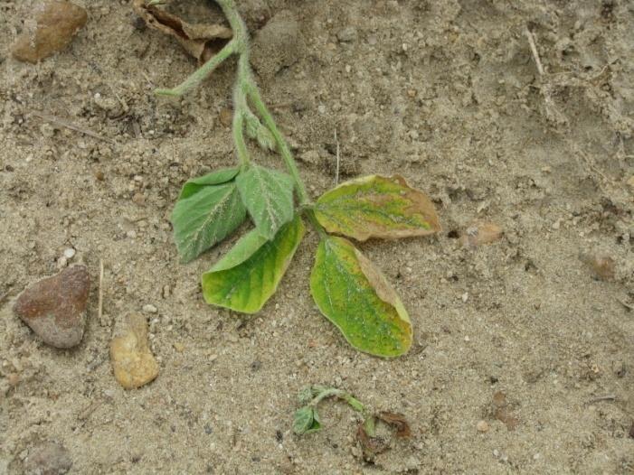
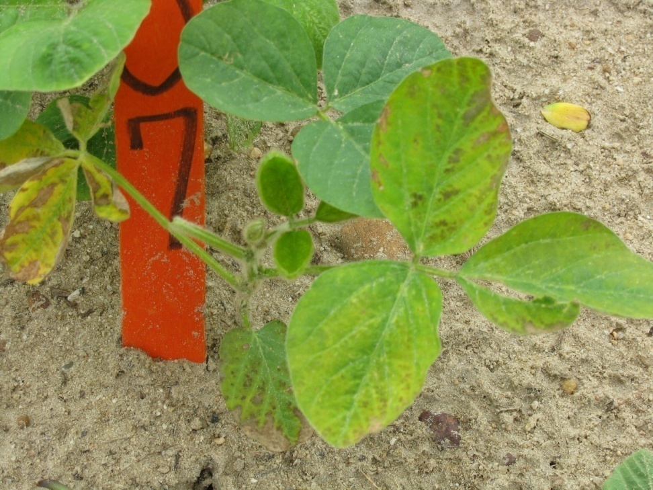
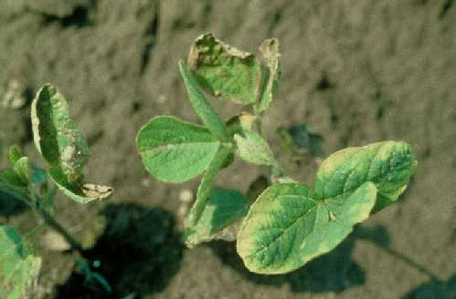
Metribuzin Injury

Slide 11
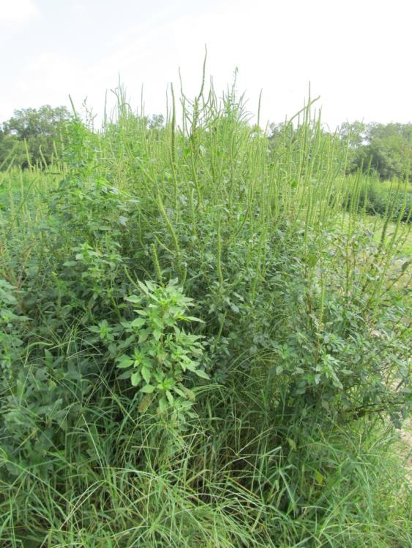
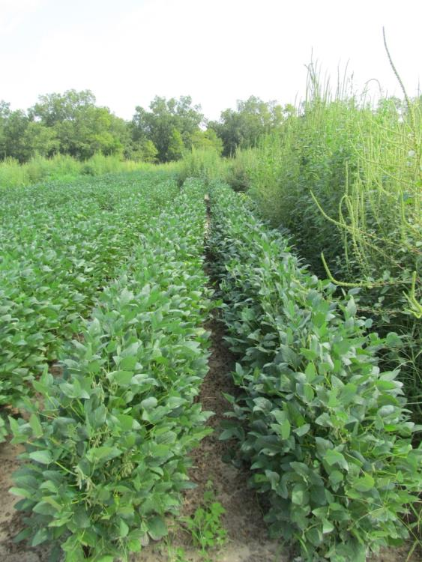
Palmer Amaranth Control in Soybeans with Metribuzin -2012
NTC
Boundary 6.5EC @ 1.5 pt/A - PRE
Roundup WM 5.5SL @ 22 oz/A – POST (June 20)
SB-10-12
August 9
78 DAP

Slide 12
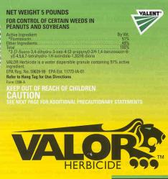











Residuals, Residuals, Residuals
Keep Using Them!!!!!!!!
TriCor 75DF

Slide 13
U.S. Soybean Acres Planted to Herbicide
Resistant Varieties
Source: NASS

Slide 14
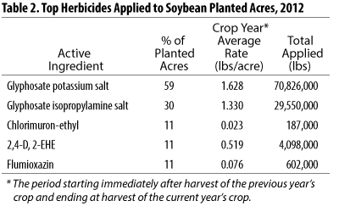
Herbicide Use in U.S. Soybeans - 2012
Source: NASS

Slide 15
Weed Control in RR Soybeans
Prostko’s Picks
Tricor, or Boundary (Tricor + Dual), or Warrant, or Dual (PRE) fb glyphosate + Reflex (POST)
  Avoid Reflex mixtures with K-salt glyphosate formulations if possible
Annual morningglory problems
  Glyphosate + Classic or FirstRate

Slide 16
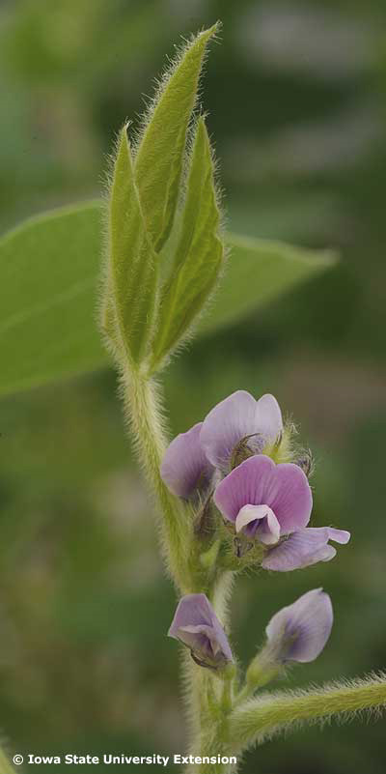
What about delayed applications of glyphosate on RR soybeans?
Current labels only allow application thru flowering stage of growth (R2 – full bloom – open flower at two uppermost nodes).
What happens if applied later?

Slide 17
Tolerance of GR-Soybean to Late-Season Glyphosate Applications (1.5 lb ai/A)
J.K. Norsworthy. 2004. Weed Technology 18:454-457
LSD 0.05 = NS

Slide 18
Soybean Yield As Influenced by Glyphosate Applied at R4 (Full Pod) + R6 (Full Seed) Stages
Source: Miller et al., 2008. Weed Technology 22:359-362
THSD 0.05 = NS

Slide 19
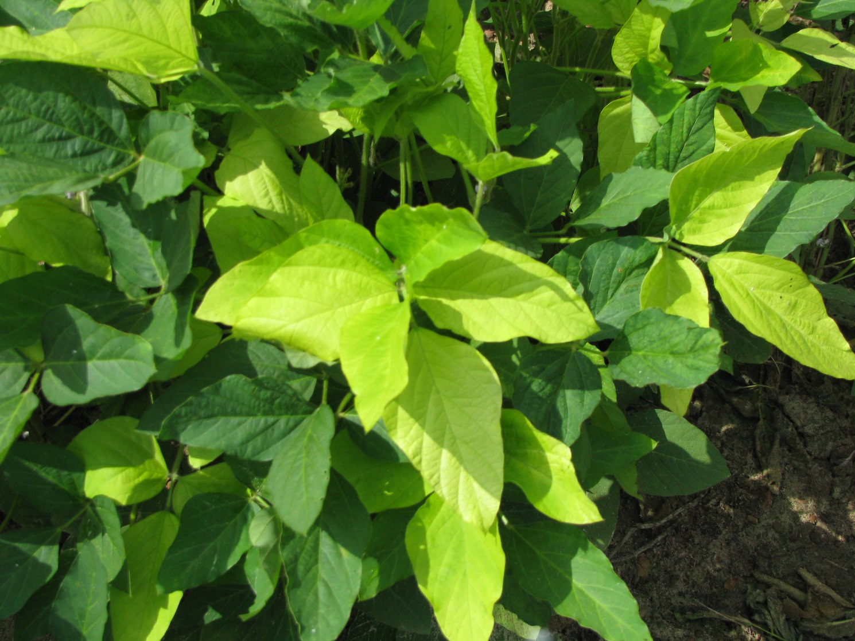
Glyphosate Yellow Flash

Slide 20
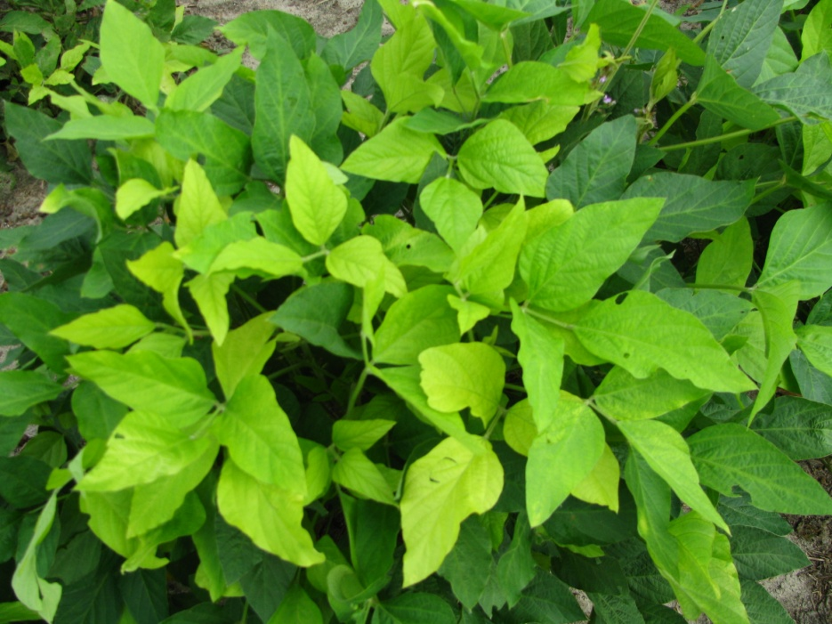
Likely Cause of Glyphosate Yellow Flash
Degradation of glyphosate to AMPA
AMPA reduces chlorophyll content in soybean
AMPA = aminomethylphosphonic Acid

Slide 21
Recent Research on Glyphosate and Mineral Accumulation
“Glyphosate is unlikely to cause macro and micronutrient deficiencies in soybean if soil nutrient levels are properly maintained.”
  Henry, R.S, K.A. Wise, and W.G. Johnson. 2011. Glyphosate’s effect upon mineral accumulation in soybean. Online. Crop Management doi:10.1094/CM-2011-1024-01-RS.
“Considering the available data, growers are unlikely to need Mn fertilizers just because they use glyphosate on GR soybeans.”
  Duke, S.O., J. Lydon, W.C. Koskinen, T.B., Moorman, R.L. Chaney, and R. Hammerschmid. 2012. Glyphosate Effects on Plant Mineral Nutrition, Crop Rhizosphere, Microbiota, and Plant Disease in Glyphosate-Resistant Crops. J. Agric. Food Chem. 60:10375−10397

Slide 22
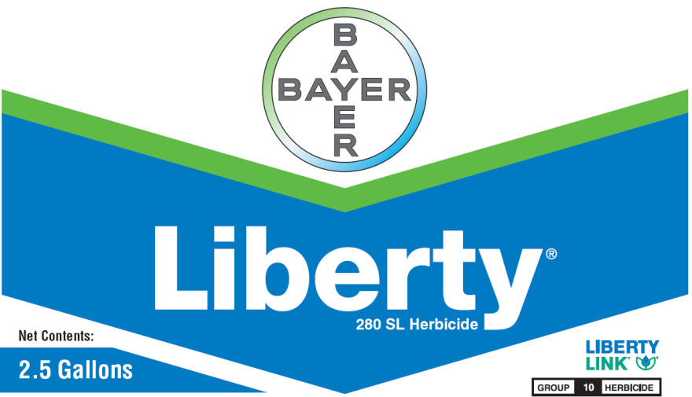
Liberty-Link® Soybeans
Liberty 2.34SL @ 22-36 oz/A
VE-R1
2 applications (65 oz/A/year total)
Tank-mixes with POST grass herbicides may reduce grass control
  Assure (10-21%); Fusilade (8-12%); Poast (25-41%); Select (4-22%)
Residuals still needed
Variety performance?
  Getting better
**Best Results
  15 GPA, medium droplet size, small weeds, 9 am - 6 pm

Slide 23
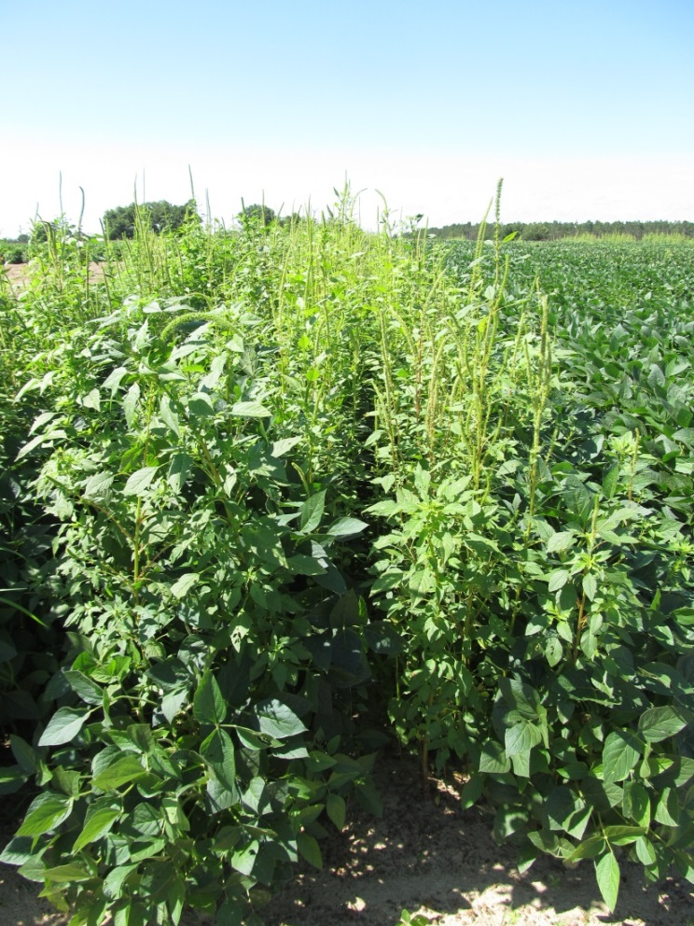
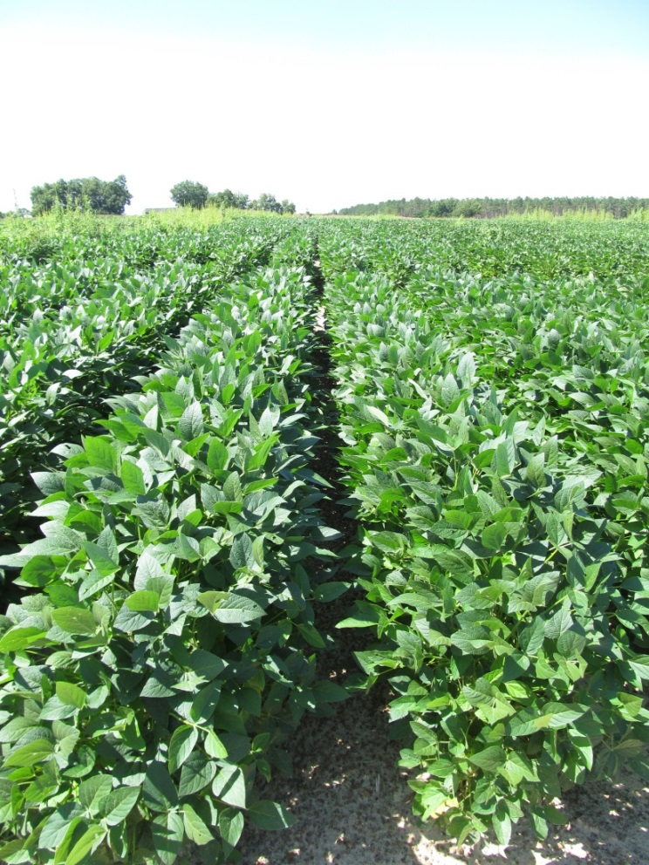
Weed Control in LL Soybeans - 2013
NTC
Dual Magnum @ 16 oz/A (PRE)
Liberty @ 29 oz/A (MPOST)
Reflex @ 16 oz/A (MPOST)
SB-23-13
July 17

Slide 24
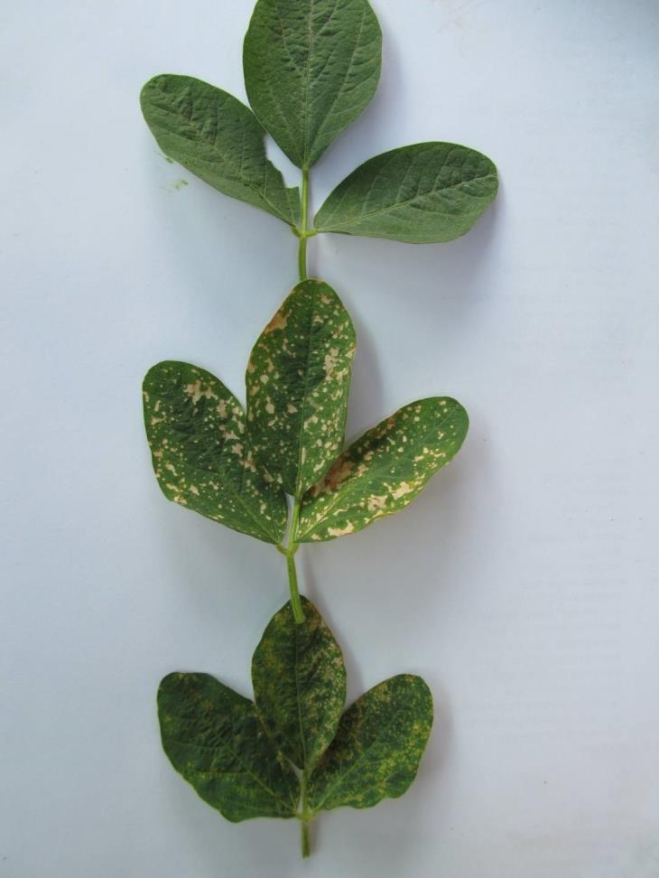
Liberty-Link
Soybeans
Liberty
Liberty +
Dual Magnum
Liberty +
Reflex
SB-04-11
6 dat

Slide 25
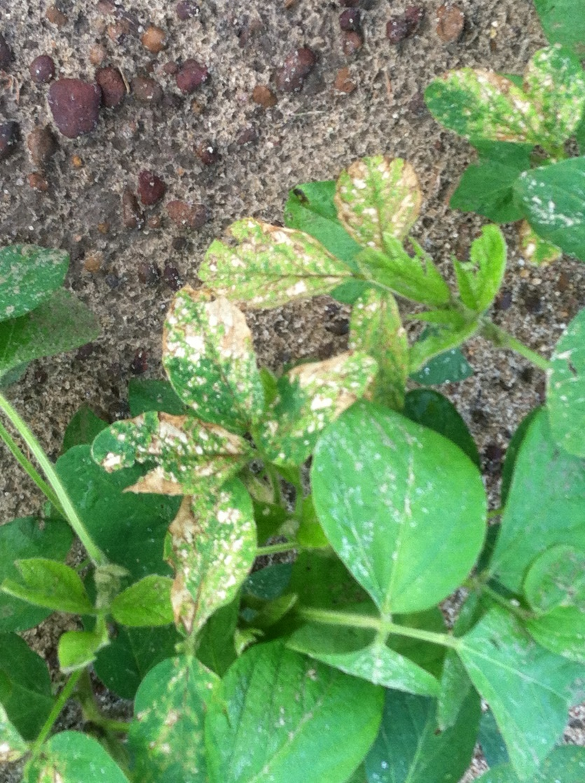
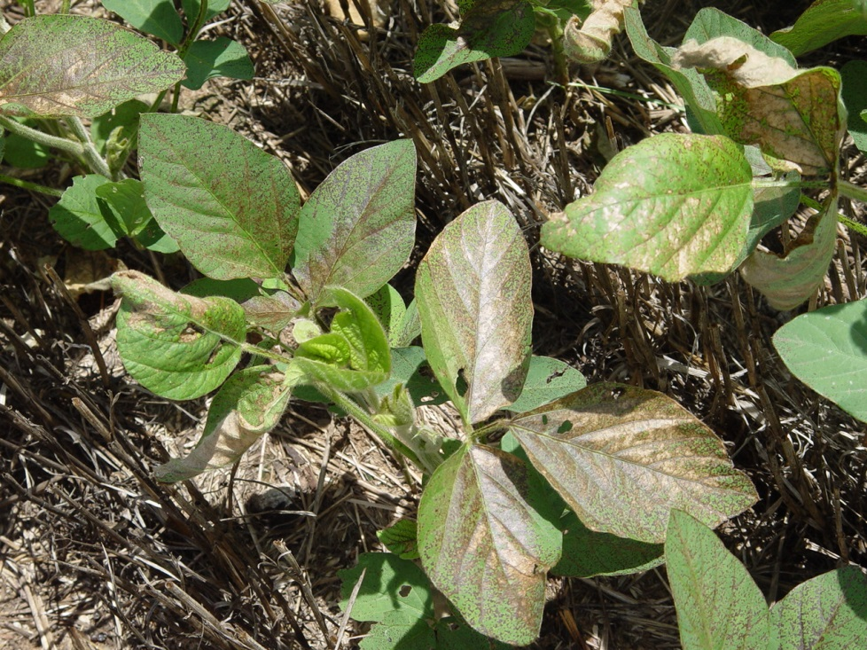
Older PPO Herbicides Will Burn Soybeans (Reflex, Cobra, Blazer)

Slide 26

Future Technologies
2,4-D resistance
Dicamba resistance

Slide 27
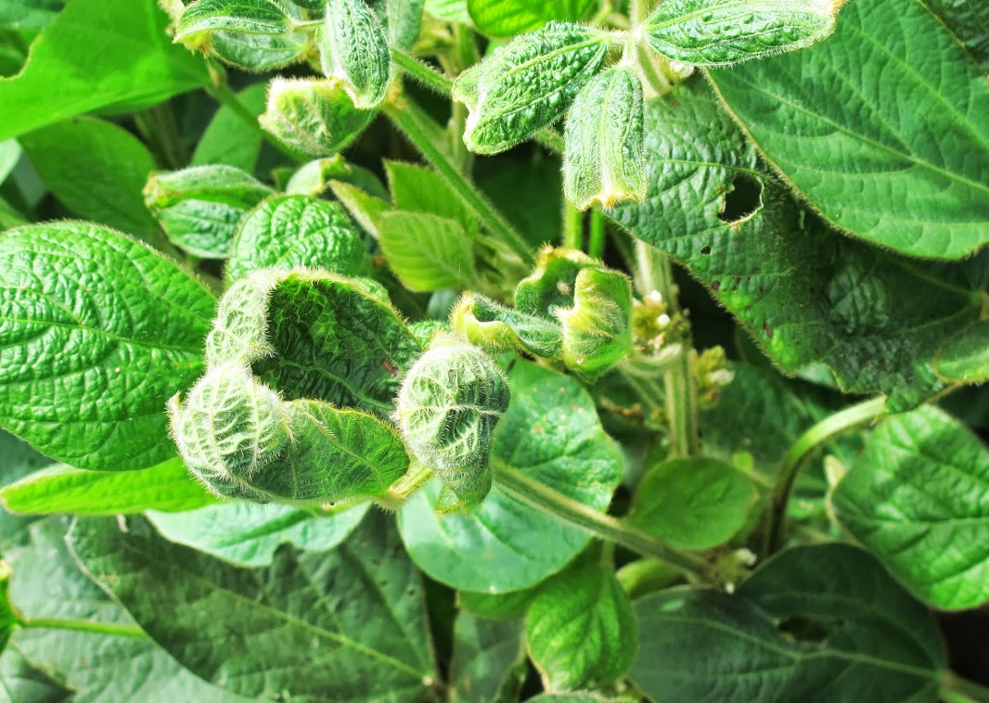

Growth Regulator Injury

Slide 28

2,4-D Tolerance Gene
DowAgrosciences
aad-1 gene
Soil bacteria
  Sphingobium herbicidovorans

Slide 29
Dicamba Tolerance Gene
Identified at University of Nebraska-Lincoln in 2007
Soil bacteria capable of utilizing dicamba as a carbon source (i.e. food)
  Pseudomonas maltophilia

Slide 30
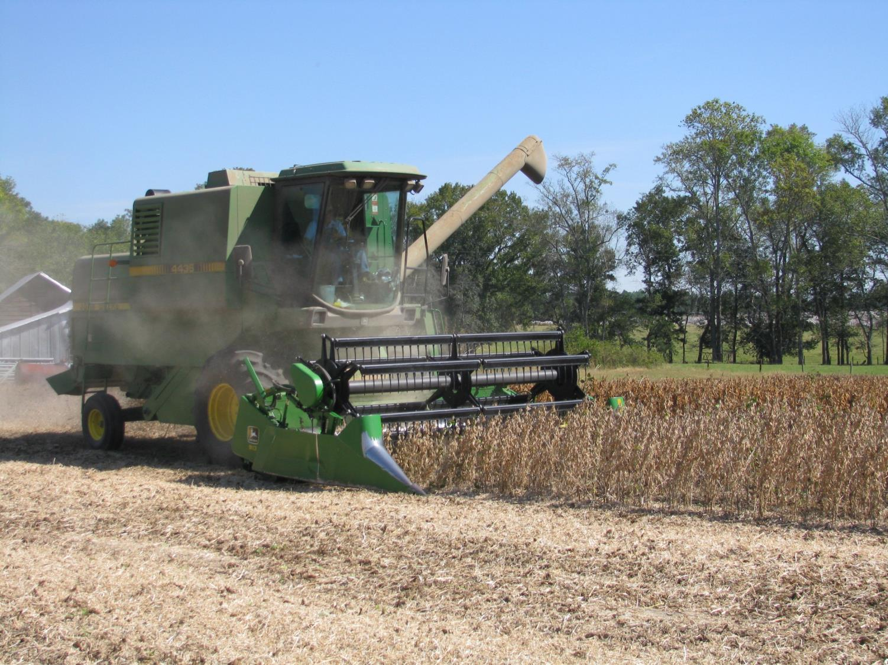
QUESTIONS?
www.gaweed.com

